Slide 1





HUMAN ACTION RECOGNATION
Gabriel EL HACHEM
Loévan LE QUERNEC
Jade FALCK

Slide 2




PROBLEM ILLUSTRATION
Understanding the Problem
Why This Is Important
What Makes This Interesting
Practical Applications

Slide 3


HOW TO SOLVE THE PROBLEM
Understand the problem
Image preprocessing
Collect data
Explore data
Feature extraction
CNN evaluation
Comparaison and insights
Computational vizualisations
Model training
MobilNetV2
evaluation

Slide 4

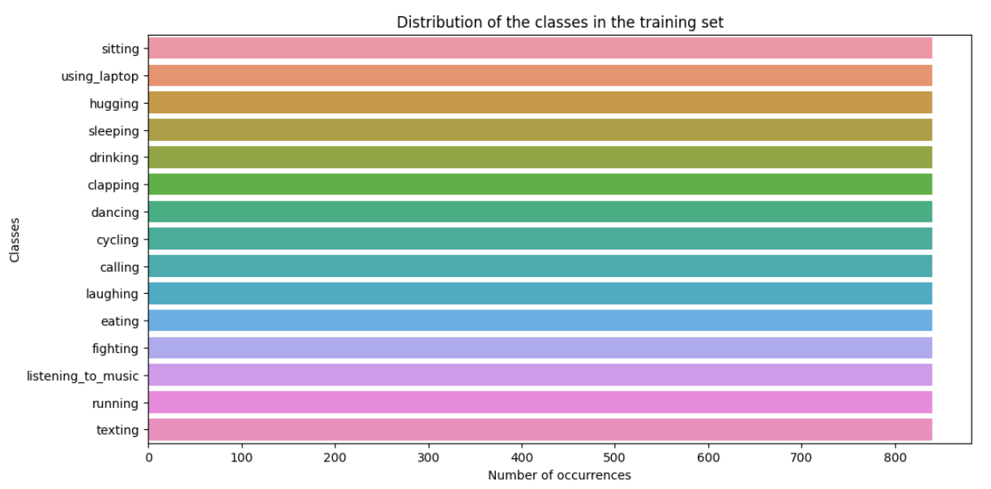
DATA

Slide 5
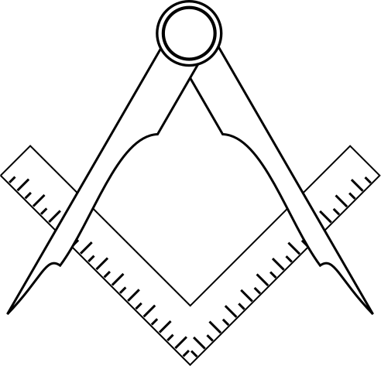
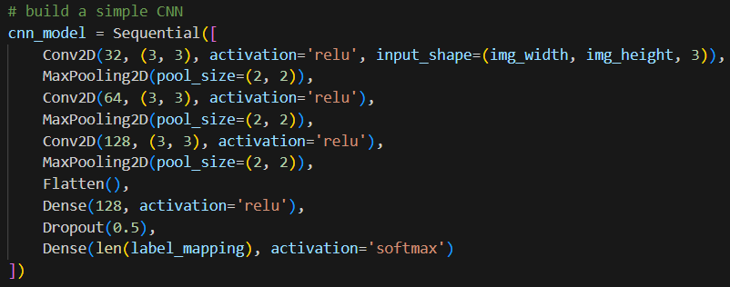
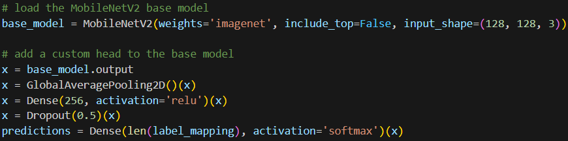
ARCHITECTURES
CNN:
MobileNetV2:

Slide 6

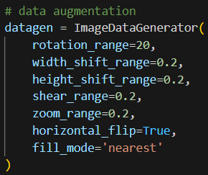
DATA AUGMENTATION
For MobilNetV2 only:
Image rotation
Horizontal and vertical shifts
Shearing
Zooming (20%)
etc...

Slide 7
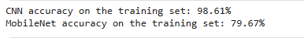
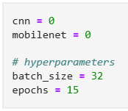
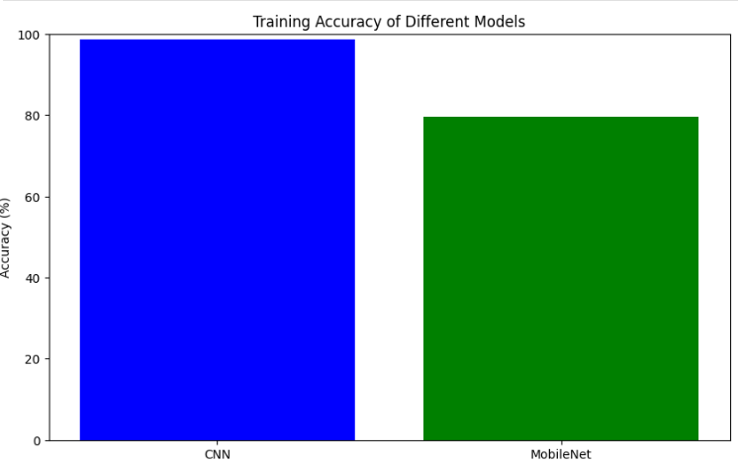
PREPROCESSING & TRAINING

Slide 8
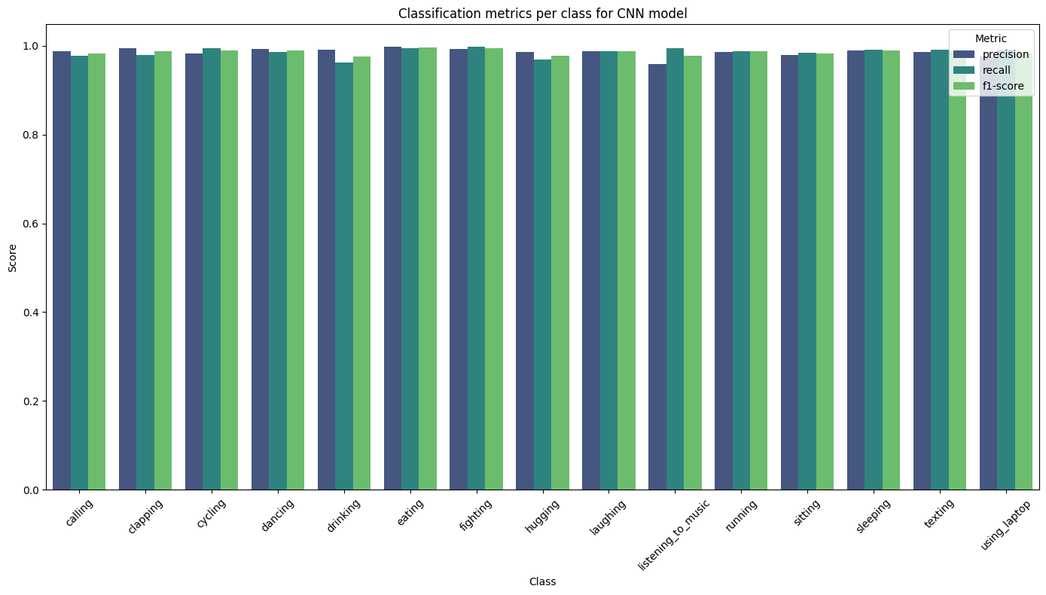
CLASSIFICATION METRICS

Slide 9
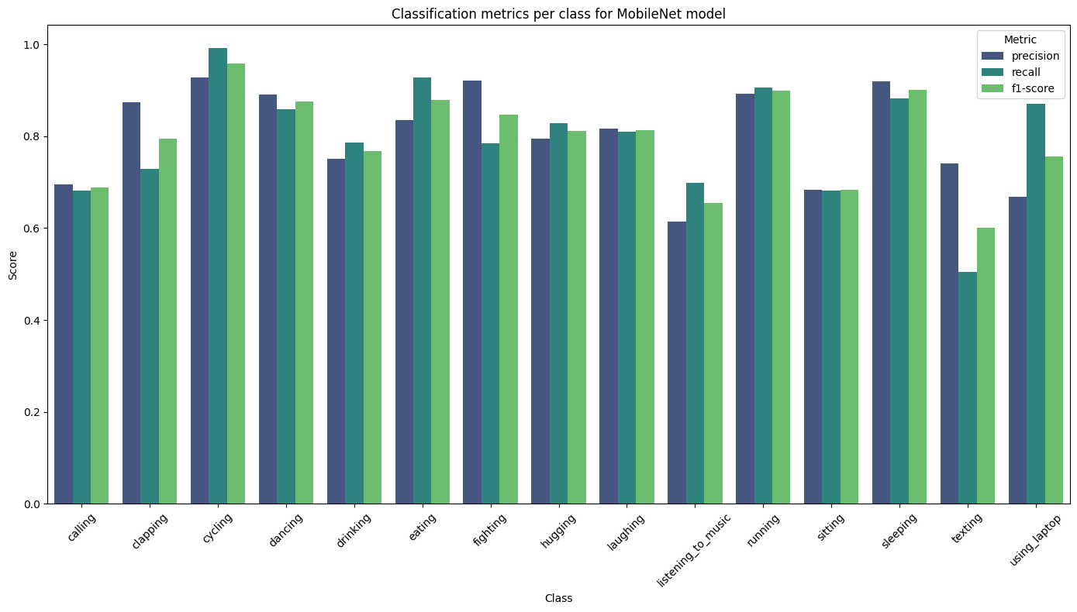
CLASSIFICATION METRICS

Slide 10
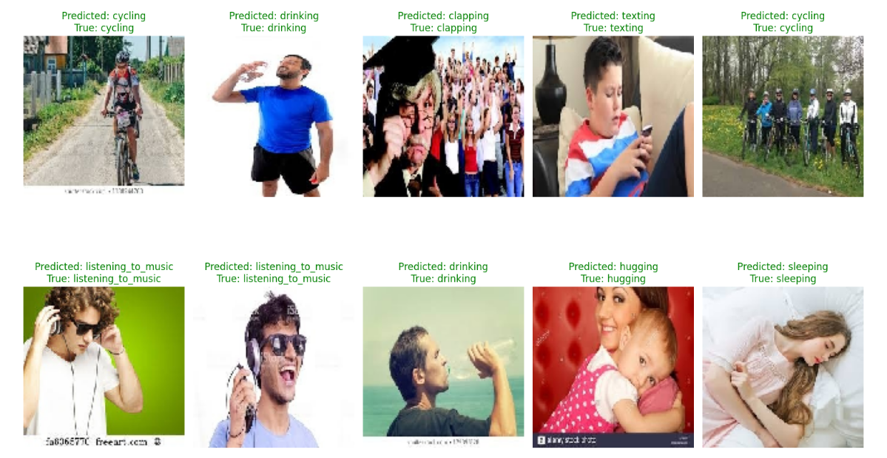
PREDICTION CNN
TRAINING SET

Slide 11
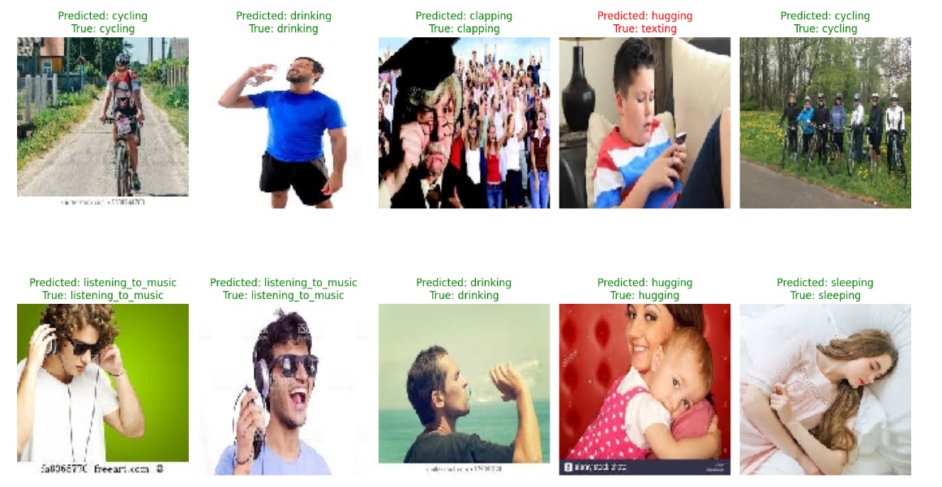
PREDICTION MOBIL NET
TRAINING SET

Slide 12
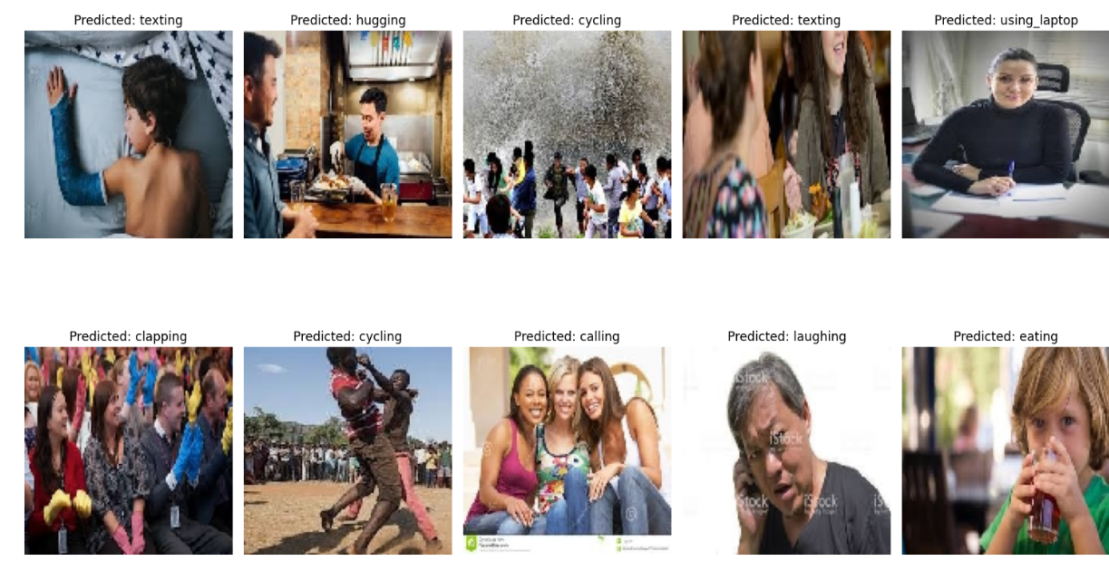
PREDICTION CNN
TESTING SET

Slide 13
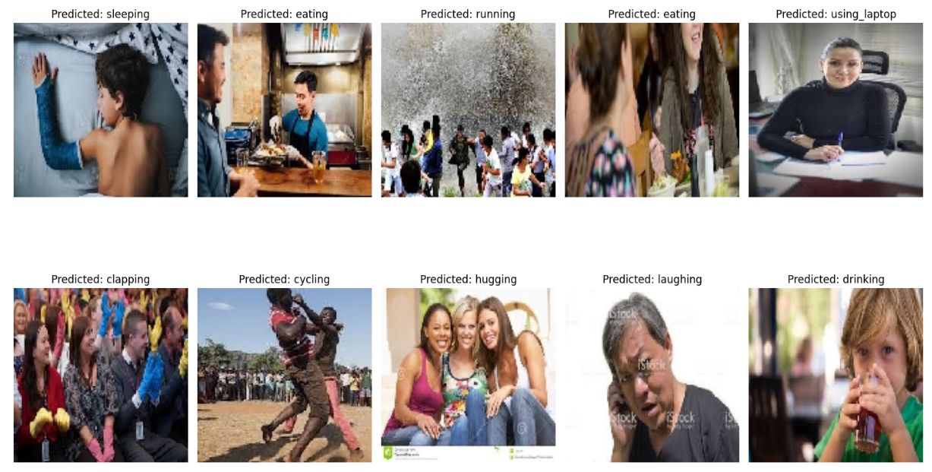
PREDICTION MOBIL NET
TESTING SET

Slide 14
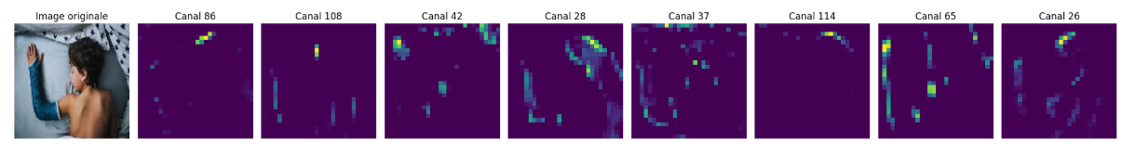
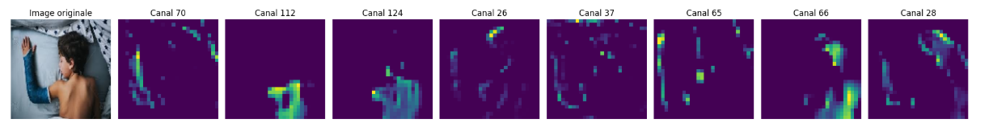
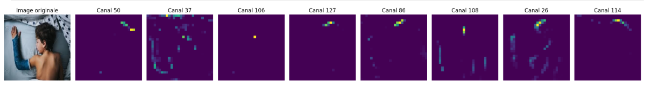
ACTIVATION MAPS
By Variance
By Mean
By Max

Slide 15
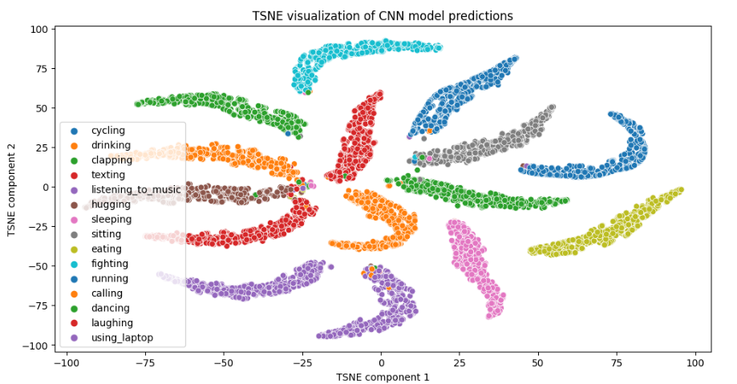
TSNE CNN MODEL

Slide 16
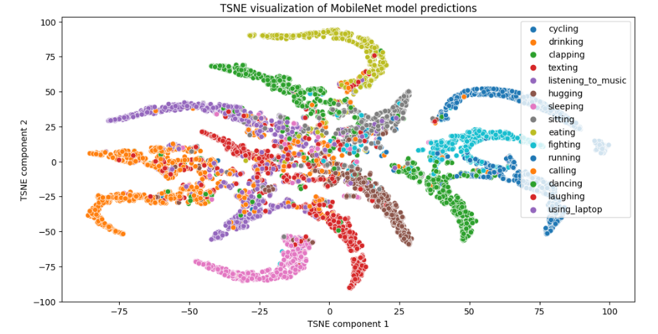
TSNE MOBILNETV2 MODEL

Slide 17


ANALYSIS & INTERPRETATION
Accuracy : CNN(98,61%) MobilNet(79,67%)
Predictions : MobilNet at generalizing to new, unseen data than CNN
Activation maps
t-SNE plots

Slide 18




THANKS FOR LISTENING!
Any questions?

